Slide 1
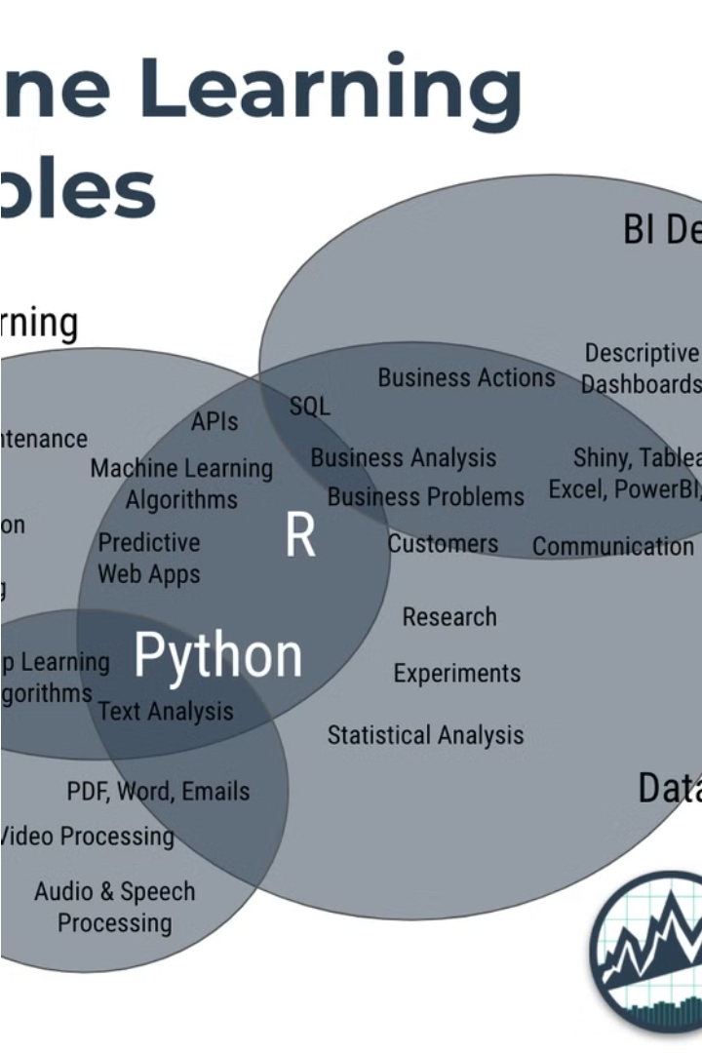
Detection of FAKE JOB POSTING USING MACHINE LEARNING
Project by:
Parth Subhash Chaudhari
Col Mukund Sarsar, SC
Guided by: Prof. Poonam Bawke

Slide 2
Contents
Introduction
Details of Project
Methodology
Result
This project aims to detect fake job postings using machine learning techniques. The introduction will provide an overview of the problem and the motivation behind the project.
The details of the project will include the specific objectives, the data used, and the various machine learning models explored to address the problem.
The methodology section will explain the step-by-step process followed in developing the machine learning models, including data preprocessing, feature engineering, and model training and evaluation.
The result section will present the performance of the different machine learning models and the insights gained from the analysis.

Slide 3


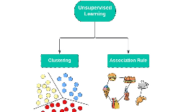
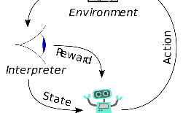
Introduction to Machine Learning
Machine Learning
Supervised Learning
Unsupervised Learning
Reinforcement Learning
Machine learning is a field of artificial intelligence that enables computers to learn and improve from experience without being explicitly programmed. It involves the development of algorithms and statistical models that allow systems to perform specific tasks effectively without using rule-based programming.
Supervised learning is a type of machine learning where the algorithm is trained on a labeled dataset, meaning the data has pre-defined inputs and outputs. The goal is to learn a function that maps the inputs to the outputs, which can then be used to make predictions on new, unseen data.
Unsupervised learning is a type of machine learning where the algorithm is trained on an unlabeled dataset, meaning the data has no pre-defined outputs. The goal is to discover patterns and structures within the data, such as grouping similar data points together or identifying anomalies.
Reinforcement learning is a type of machine learning where the algorithm learns by interacting with an environment and receiving feedback in the form of rewards or penalties. The goal is to learn a policy, or a set of actions, that maximizes the cumulative reward over time.

Slide 4
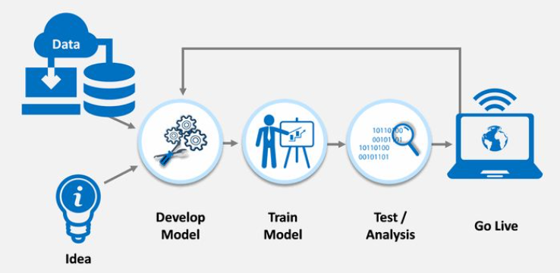
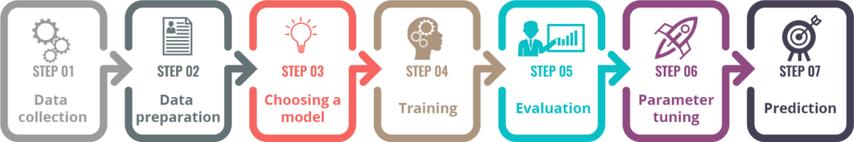
Process of a ML Project Development
Fig. 1.4 : steps of development

Slide 5

Problem Statement
This project aims to develop a machine learning model to accurately identify and classify fake job postings using a dataset from Kaggle. The goal is to enhance the security and reliability of online job portals by filtering out fraudulent listings, thereby protecting job seekers from scams and potential harm.

Slide 6
Objectives / Motivation Scope
The objective is to obtain fake job predictions using machine learning techniques and reduce the frauds and scams. The motivation is to leverage the power of machine learning to identify and mitigate the growing problem of fake job postings, which can lead to significant financial and emotional harm for job seekers.

Slide 7

Methodological Details
Dataset
Libraries
The dataset used for this project was obtained from Kaggle and consists of 17,880 instances with 18 attributes.
The project utilized the following libraries: string, pandas, numpy, matplot, and sklearn.
Algorithms
The following algorithms were implemented in the project: 1. Logistic Regression, 2. K-Nearest Neighbours, 3. Decision Tree, 4. Support Vector Machine, and 5. Random Forest.

Slide 8
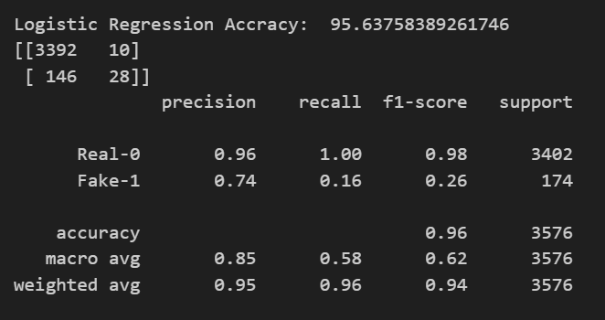
Logistic Regression Results
95.63% Accuracy
Logistic regression is a statistical method used for binary classification problems. It models the probability of a given input belonging to one of two classes by fitting data to a logistic function, producing a value between 0 and 1. This value can be interpreted as the likelihood of the input being in a specific class, making logistic regression a powerful tool for predicting categorical outcomes.

Slide 9
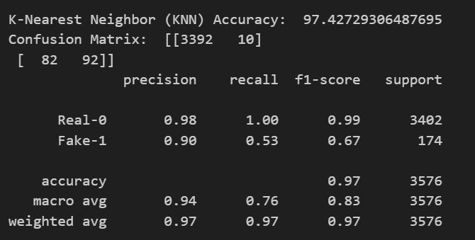
K Nearest Neighbor Results
97.42% Accuracy
K-Nearest Neighbors (KNN) is a simple, non-parametric algorithm used for classification and regression tasks. It works by finding the 'k' closest training examples to a given query point and making predictions based on the majority class (for classification) or the average (for regression) of these neighbors. KNN is intuitive and easy to implement but can be computationally expensive for large datasets.

Slide 10
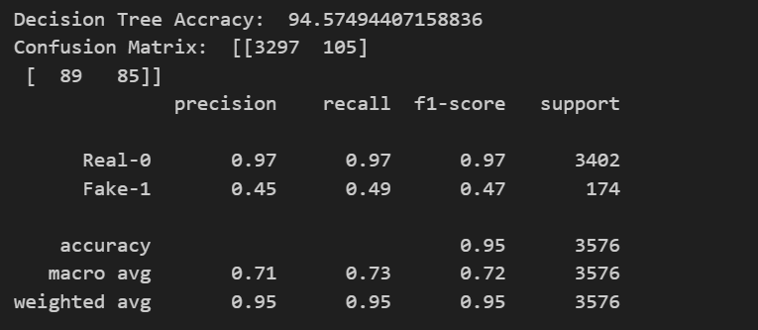
Decision Tree Results
94.57% Accuracy
A decision tree is a machine learning algorithm used for classification and regression tasks. It models decisions and their possible consequences as a tree-like structure, where each internal node represents a test on a feature, each branch represents an outcome of the test, and each leaf node represents a class label or a continuous value. Decision trees are intuitive and easy to interpret but can be prone to overfitting without proper pruning.

Slide 11
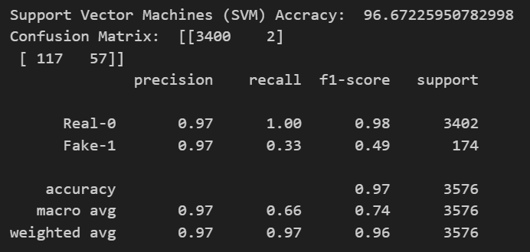
Support Vector Machine Result
96.67% Accuracy
Support Vector Machine (SVM) is a supervised machine learning algorithm used for classification and regression tasks. It works by finding the optimal hyperplane that best separates the data into different classes. SVM is effective in high-dimensional spaces and is known for its ability to handle both linear and non-linear data through the use of kernel functions.

Slide 12
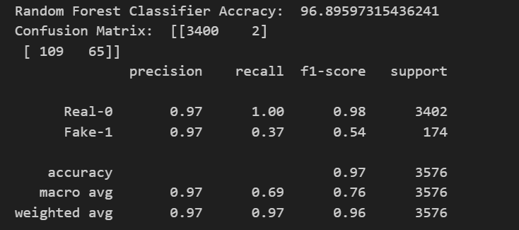
Random Forest Result
96.89% Accuracy
Random Forest is an ensemble learning method used for classification and regression tasks. It operates by constructing multiple decision trees during training and outputting the mode of the classes (classification) or mean prediction (regression) of the individual trees. This technique improves accuracy and helps prevent overfitting by averaging the results of many trees.

Slide 13
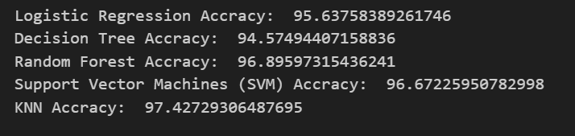
MODEL COMPARISION WITH DETAILED ACCURACY

Slide 14
Model Comparision
Model Name
Accuracy
Logistic regression
0.95
K-nearest Neighbors
0.97
Decision trees
0.94
Support vector machine
0.96
Random Forest
0.96

Slide 15
Conclusion
1
Analyzed given data set
2
Best accuracy
using various machine learning algorithms
is achieved by K-NN with 97.42%

Slide 16



Thank You
Email
Department
Student Name
chaudhariparth1809@gmail.com
Department of Technology, Savitribai Phule Pune University, Pune.
Parth Subhash Chaudhari (PGD23DS18)
sarsarmukund@gmail.com
Col Mukund Sarsar, SC (PGD23DS43)

